Slide 1
Educator Effectiveness
CFMS Staff Meeting, January 2013

Slide 2
New Expectations
NCLB… Whoops. Not going to work.
ESEA Waiver
Agenda 2017

Slide 3
Agenda 2017
Increase graduation rate from 85.7% to 92%
Increase career and college readiness from 32% to 67%
Close graduation and career / college readiness gaps by 50%
Increase percentage of students score proficient in third-grade reading and eighth-grade math
Adopt the Fair Funding for Our Future Plan
Notes:
Goals of Agenda 2017. Do these look familiar? They should. The first four bullets are the components measured by our school report card.

Slide 4
Agenda 2017, continued
Standards and Instruction
Common Core
Assessment and Data Systems
SMARTER Balanced
RtI
School and Educator Effectiveness
Report Card
Educator Evaluation System
School Finance Reform
Notes:
This how Wisconsin explains its action steps that are part of the Agenda 2017 plan.

Slide 5
Educator Effectiveness Model

Slide 6
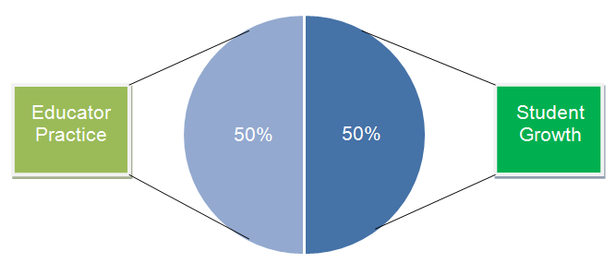
Evaluation Weights

Slide 7
Educator Practice
Annual evaluation performed by supervising administrator(s)
Consists of announced, unannounced formal observations as well as walk-throughs
Multiple observations per year
Common format state-wide

Slide 8
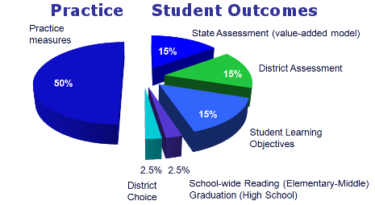
Student Growth

Slide 9
Student Learning Outcomes
Format similar to a SMART Goal
1-3 SLOs required
Team option
Fall: Set goal, determine measure
Winter: Progress Check
Spring: Outcome Check with 4 point scoring
Stillson is piloting

Slide 10
Timeline
2012-2013: Initial Pilot
2013-2014: Expanded Pilot
2014-2015: Implementation

Slide 11
Good Questions
State assessment: Raw scores versus school report card versus “my” students’ growth rates?
Are we all being evaluated based on reading, writing, and math skills?
What about kids who parents are unsupportive?
Who are considered “my” kids?
So, essentially, I am evaluated based on student performance rather than my efforts?

Slide 12
http://ee.dpi.wi.gov/ee_home

