Slide 1

Chippewa Falls
Facilities Task Force
Fall 2015

Slide 2
Agenda for Meeting Two
Review Planning Process
Reflecting on What We’ve Learned
‘Stomping On’ Creativity
History of Learning
Creating Tomorrow
Need to Know Information
Next Steps Meeting Calendar
Notes:
Review planning Process (5 min)- This will bring members who missed the first session up to speed.
Facilities Presentation (40 min)- This is a comprehensive presentation of the findings of the facilities study conducted by ATSR
Large Group (15 min)- This is a ‘quick take’ feedback loop. All committee members are asked to reflect on what they heard and its implications.
Finance/Facility Presentation (20 min)- This is a presentation by either the Superintendent and/or Representatives from Drown Assoc.
Large Group (15 min)- This is a ‘quick takeaway’ session where committee gives feedback related to what they have heard and what it means
Next Steps (10 min)- Review of planning calendar. Also address any ‘unresolved’ issues.
Total anticipated time: 105 minutes

Slide 3

CFAUSD/ATSR Planning Process
P
R
O
C
E
S
S
Gather
create
Trust the Process
Information
solutions
It Works!
Meeting
Meeting
Meeting
Meeting
Meeting
1
2
3
4
5

Slide 4
‘Important Takeaways’: A Little of What We Learned !
You want to have a better understanding of how things work.
You want to have an ‘infrastructure’ that is sound; providing quality learning environments for a long time.
You want to learn about the changes that are taking place in the teaching/learning process.
You want to be certain that you have a plan for facility updates/upgrades; establish a clear set of priorities.
You want facilities that are safe and nurture and support the learning process.

Slide 5
Important ‘Takeaways’: You’re Turn!
You heard a ‘ton’ of information at your first meeting. What impressions remain strongest in your mind today?

Slide 6
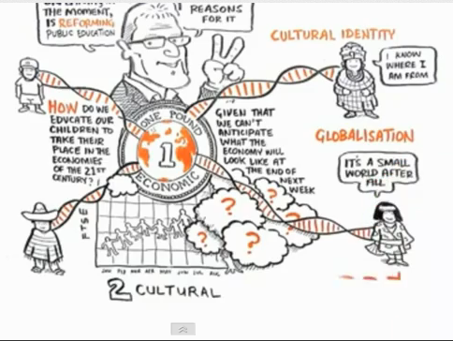
Education Evolving
“Changing Educational Paradigms”

Slide 7
Quick Takes!
What did you find interesting that relates to your own thoughts about the Chippewa Falls School’s Educational Program?

Slide 8
History of Education: A Journey Through Time
Innovation
“At no time in history have schools been asked to prepare students for as many careers that do not yet exist!”
Knowledge
No Child Left
Behind
Accountability
National Standards
Instructional
Technology
New Immigrants
The World is Flat-
STEM vs Arts vs
Invention
Technology (Information Freeway)
New Immigrants
Technology
Nation at Risk
State Standards
Competition driven education i.e. vouchers, charters, PSEO,
home-schools
Technology (information highway)
New Immigrants
Baby Boom/School
Building Explosion
Sputnik/ ‘New’
Math and Science
Civil Rights
Open Classrooms/
Student
Empowerment
Title IX
Special Education
Industry
Compulsory
High School
Vocational
Programs
Women’s Entry
into professions
New Immigrants
Agriculture
Non-
Compulsory
Reading/Writing
/Arithmetic
1700-L1800
L1800-M1900
M1900-M/L1900
L1900-2000
2000- Present

Slide 9
CFAUSD: Chasing History
Industry
Technology
Knowledge
Innovation
L1800-M1900
M1900-M/L1900
L1900-2000
2000- Present
Southview Elem. 1952
Stillson Elem. 1930
Stillson Elem. 1949/57
Korger-Chestnut 1925
Hillcrest Elem. 1964
Jim Falls Elem. 1964
Stillson Elem. 1963/85
Sr. High School 1959
Sr. High School 1964
District Office 1964
Halmstad Elem. 1971
Hillcrest Elem. 1969/91/01
Jim Falls Elem. 1992
Parkview Elem. 1995
Southview Elem. 1988/91
Stillson Elem. 1990/94
Middle School 1977
Sr. High School 1971/74/97
District Office 1991
Halmstad Elem. 2001/05/14
Jim Falls Elem. 2010/2014
Southview Elem. 2001/11
Stillson Elem. 2014
Sr. High School 2014
Korger-Chestnut 2009
Compulsory
High School
Vocational
Programs
Women’s Entry
into professions
New Immigrants
No Child Left
Behind
Accountability
National Standards
Instructional
Technology
New Immigrants
The World is Flat-
STEM vs Arts vs
Invention
Technology (Information Freeway)
New Immigrants
Baby Boom/School
Building Explosion
Sputnik/ ‘New’
Math and Science
Civil Rights
Open Classrooms/
Student
Empowerment
Title IX
Special Education
Nation at Risk
State Standards
Competition driven education i.e. vouchers, charters, PSEO,
home-schools
Technology (information highway)
New Immigrants

Slide 10
Education Evolving
C ompetence
C ommunication
C ollaboration
C reativity
C onsumerism

Slide 11
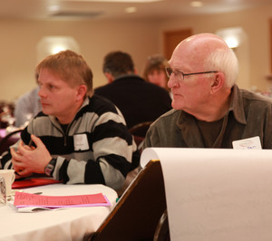
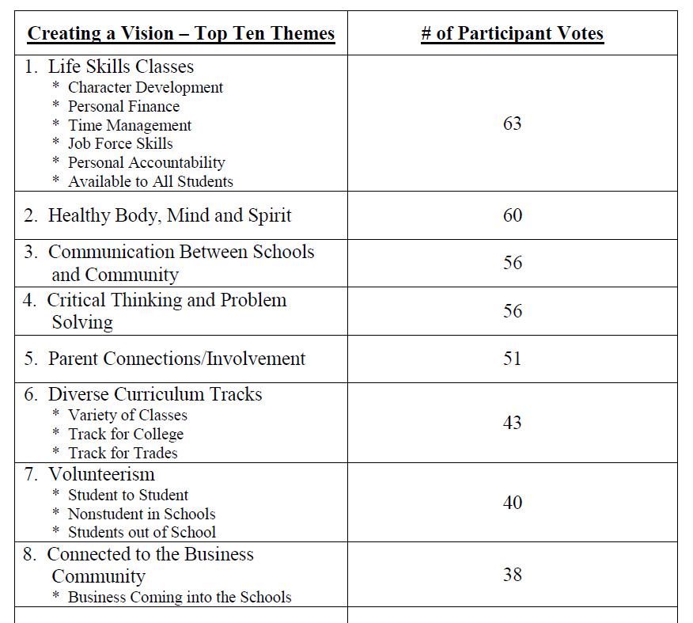
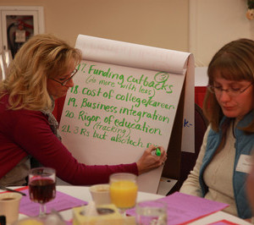

Community Conversation Themes

Slide 12
Committee Members’ Visions
Describe what the Chippewa Falls Area United Schools will look like five (5) years from now.
Time to “Step Off the Escalator”
What steps were taken to get there?
Pathway?
“Form Follows Function”

Slide 13
CFAUSD/ATSR Planning Process
P
R
O
C
E
S
S
Gather
create
Trust the Process
Information
solutions
It Works!
Meeting
Meeting
Meeting
Meeting
Meeting
1
2
3
4
5

Slide 14
Critical Information Needs
Tell us what information you believe you need to assist you in fulfilling your task!

Slide 15
Next Meeting and Future Meeting Dates
Next Meeting: Tuesday, November 17th
  Tentative Agenda: Creating Options
Future Meeting Dates: Monday November 30th and Monday December 14th.

Slide 17
Planning Process Overview
The purpose of the CFAUSD Facilities Planning Committee will be to, “…. review all information that has been developed for, and approved by, the Chippewa Falls Area Unified School District Board related to the current conditions of its facilities and make recommendations to ensure those facilities support 21st century learning….”
The process that will be used in the development of Committee recommendation(s) will:
  Involve participation in five (5) meetings that will take place over a period of ten (10) to twelve (12) weeks.
  Be inclusive in nature; recognizing the importance of both individual thought as well as consensus of small group and large group ‘think.’

Slide 18
Chippewa Falls
Facilities Task Force
Fall 2015

Slide 19
Agenda for Meeting One
ATSR Introductions
Overview of Planning Process
Committee Member Introductions
Small Group Activity “Imagine”
Identification of Critical Information
Meeting Calendar
Notes:
In the first meeting, the committee becomes acquainted with their task and begins to ‘experience’ the planning process.
ATSR Introductions (10 min.) Facilitators will introduce themselves including related background experiences. Dean will talk more broadly about ATSR.
Overview (10 min.) Facilitator will go over the charge of the committee and respond to any questions.
Committee Introductions (30 min) These introductions are actually the first exercise. Committee members will be asked to make a simple statement of ‘what they hope the outcome’ of the committee work will be. This information will provide direction for future meetings for ATSR as well as be a ‘display’ of the congruence of expectations.
A Little History (15 min)- is a presentation of the changing nature of education. It will ‘merged’ with the history of building changes in R-P; showing the relationship between building and programs.
Small Group (30 min) This activity is designed to introduce the committee to the small group process and developing a consensus. If time allows, the groups will be asked to respond to the question “How did we get there?”
Critical Information (5 min)- This is a large group feedback loop designed to provide the facilitators with a ‘to do’ list that ensures the committee has the kind and quality of information they need to make a decision.
Calendar (5 min)- This is a quick review of the calendar and affirmation of dates.
Total Planning Time 105 minutes

Slide 20
Review The Planning Process
The purpose of the Future Facilities Planning Committee will be to, “…. review all information that has been developed for, and approved by, the Chippewa Falls Area Unified School District Board related to the current conditions of CFAUSD facilities and make recommendations to ensure its facilities support 21st century learning….”
The process that will be used in the development of the recommendation will:
  Involve participation in five (5) meetings that will take place over a period of ten (10) to twelve (12) weeks
  Be inclusive in nature; recognizing the importance of both individual thought as well as consensus of small group and large group ‘think.’

Slide 21
Facilities Study
The information was gathered/analyzed through:
ATSR ‘GEMS’ Protocol
Engineers’ Review of School Sites and Previous Study
Interviews of key stakeholders such as maintenance engineers, administrators, teachers, parents, students, community members
Comparative state standards

Slide 22
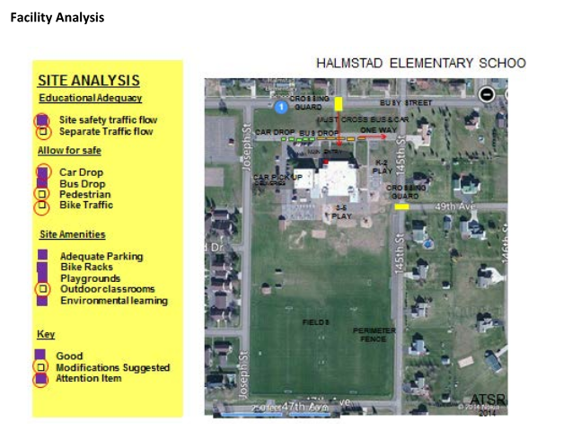
Halmstad Elementary

Slide 23
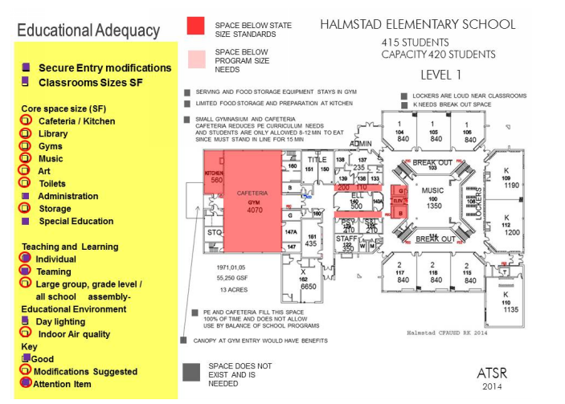
Halmstad Elementary

Slide 24
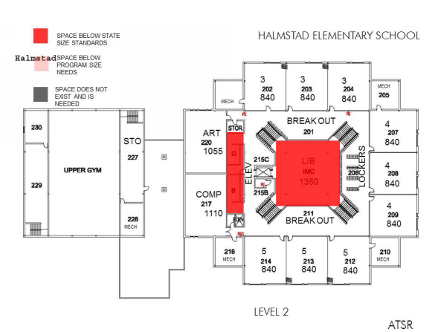
Halmstad Elementary

Slide 25
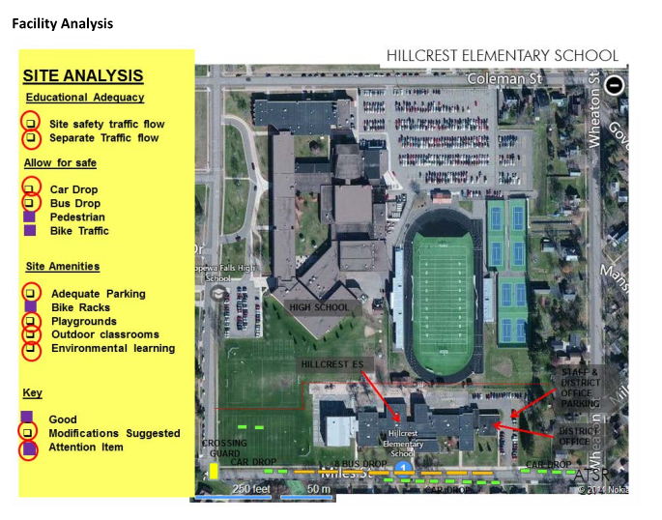
Hillcrest Elementary

Slide 26
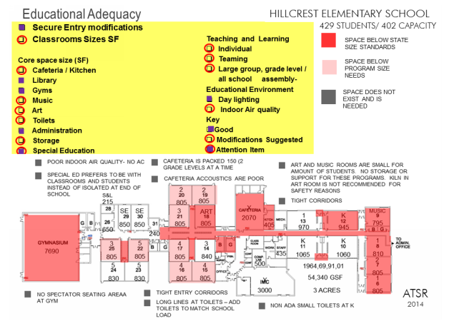
Hillcrest Elementary

Slide 27
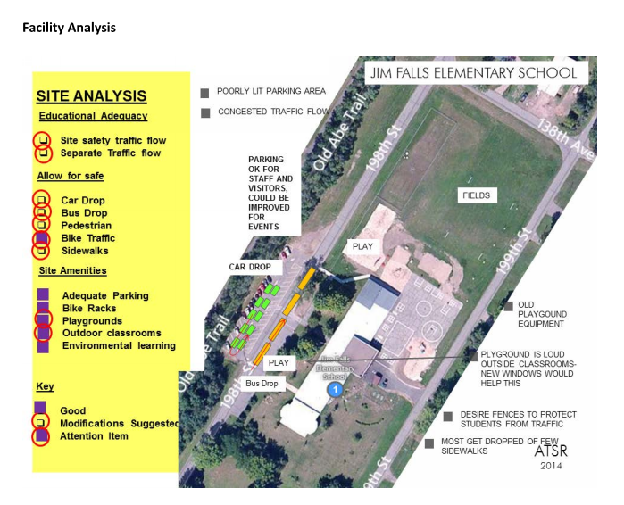
Jim Falls Elementary

Slide 28
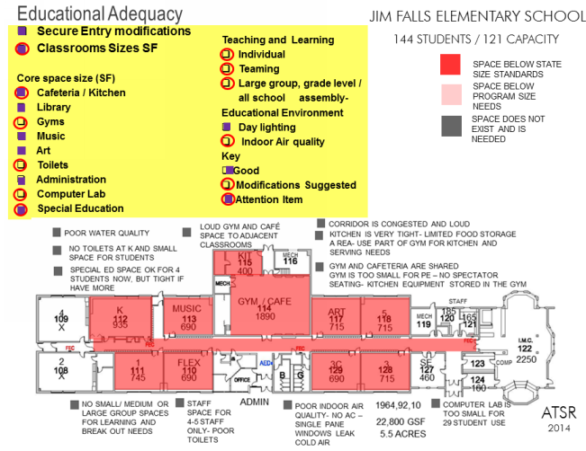
Jim Falls Elementary

Slide 29
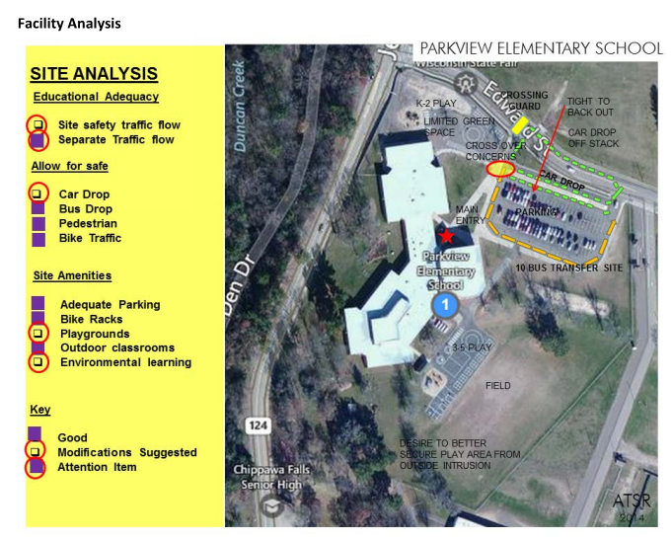
Parkview Elementary

Slide 30
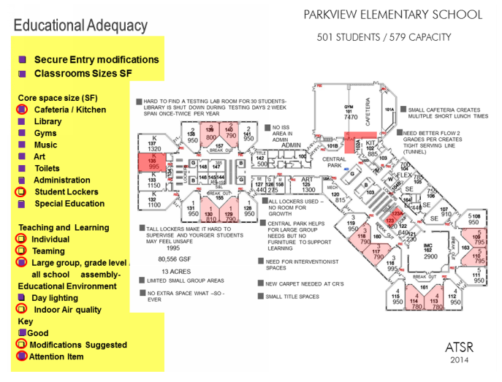
Parkview Elementary

Slide 31
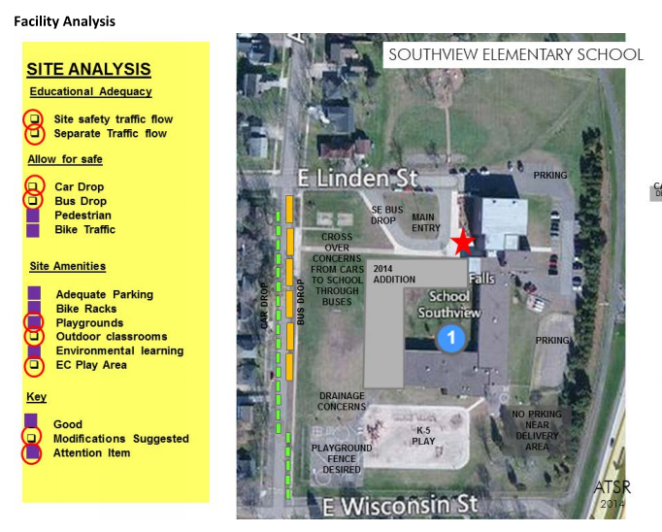
Southview Elementary

Slide 32
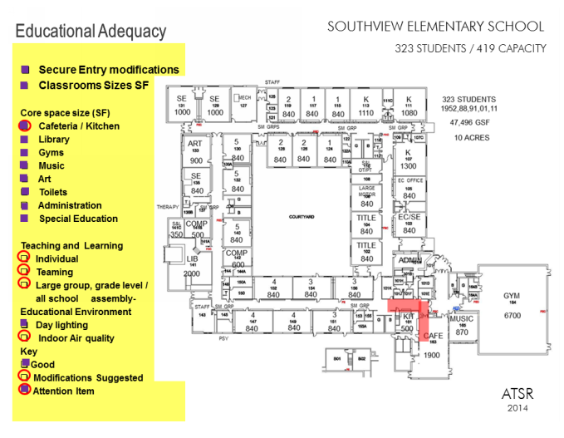
Southview Elementary

Slide 33
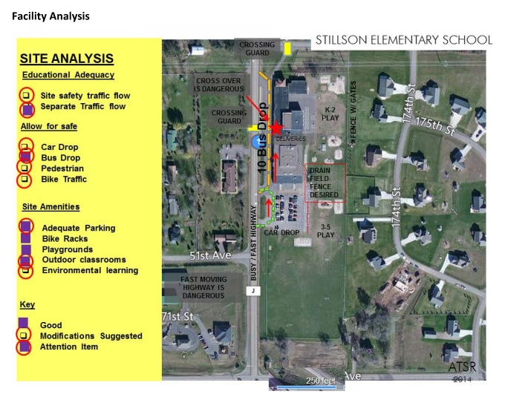
Stillson Elementary

Slide 34
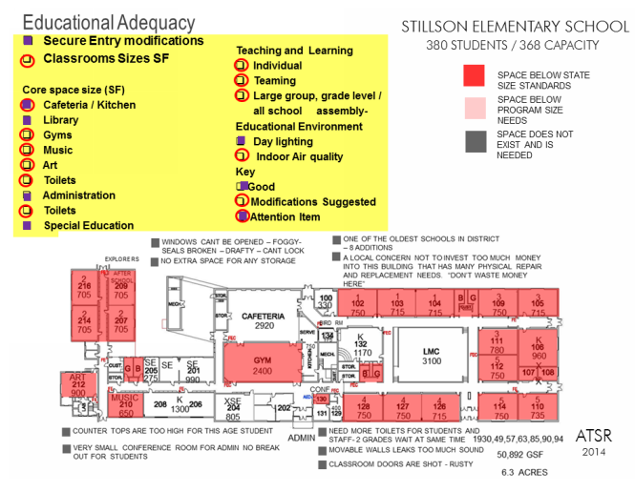
Stillson Elementary

Slide 35
Reflections/Understandings
What are some of the ‘key take-aways’ that you heard related to the conditions/needs of the elementary schools?

Slide 36
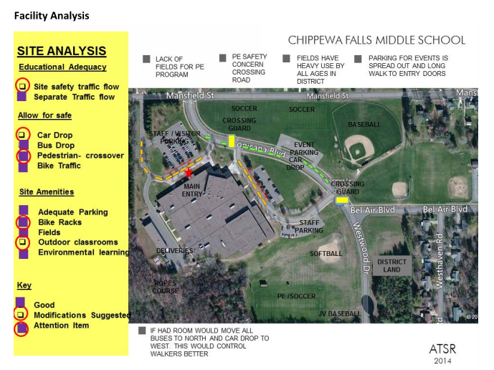
Chippewa Falls Middle School

Slide 37
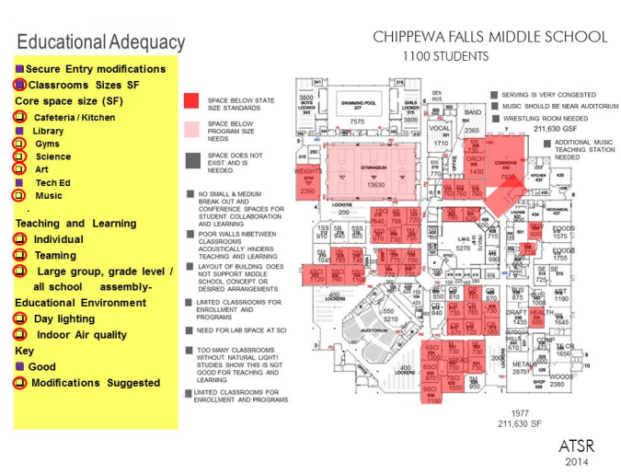
Chippewa Falls Middle School

Slide 38
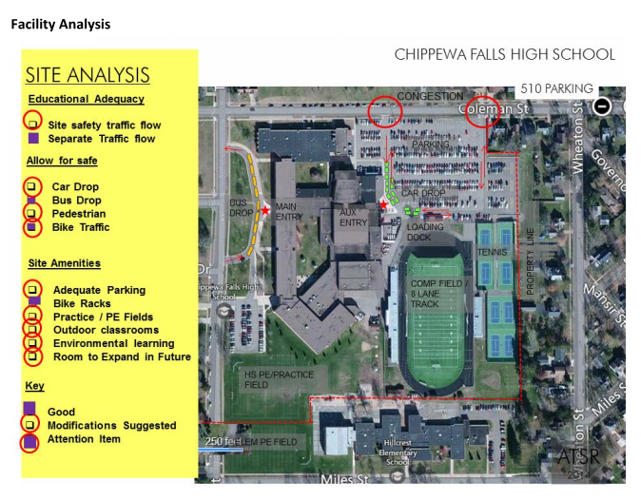
Chippewa Falls Senior High School

Slide 39
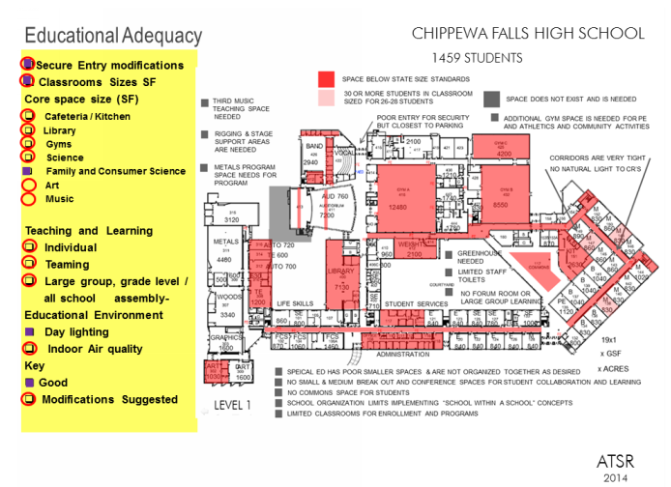
Chippewa Falls Senior High School

Slide 40
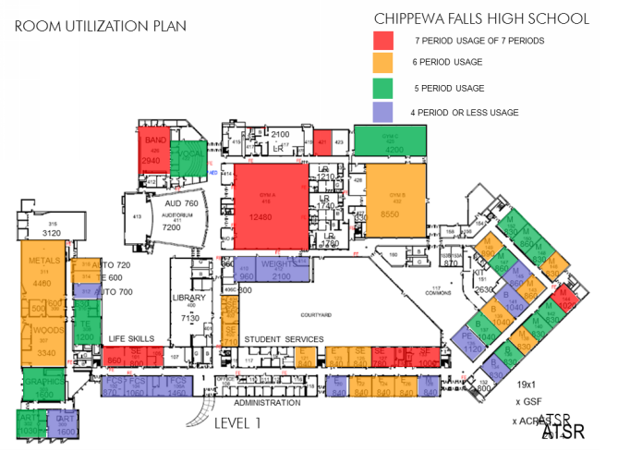
Chippewa Falls High School

Slide 41
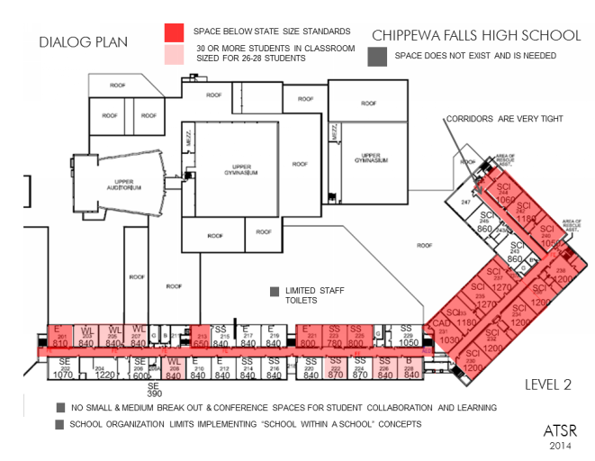
Chippewa Falls High School

Slide 42
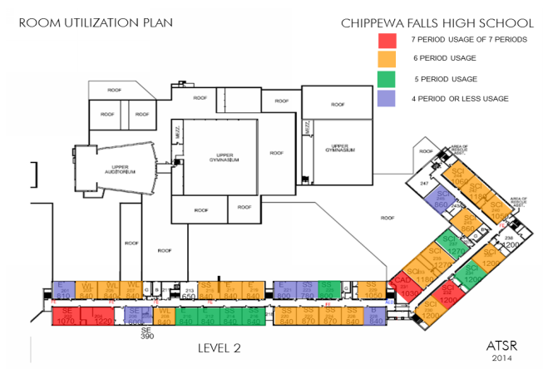
Chippewa Falls High School

Slide 43
Reflections/Understandings
What are some of the ‘key take-aways’ that you heard related to the conditions/needs of the secondary schools?

Slide 44
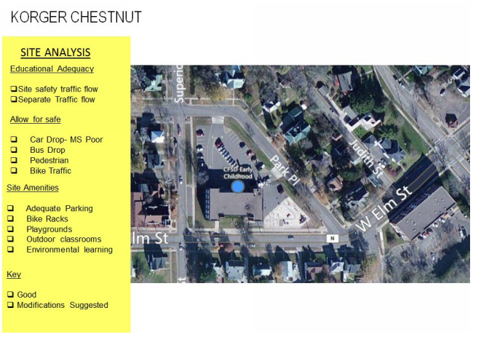
Korger Chestnut School

Slide 45
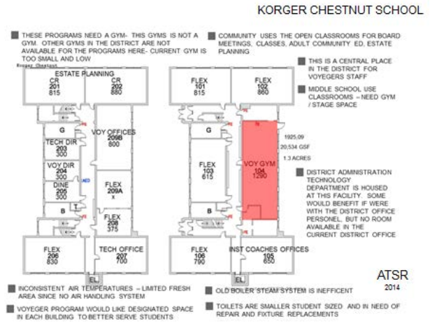
Korger Chestnut School

Slide 46
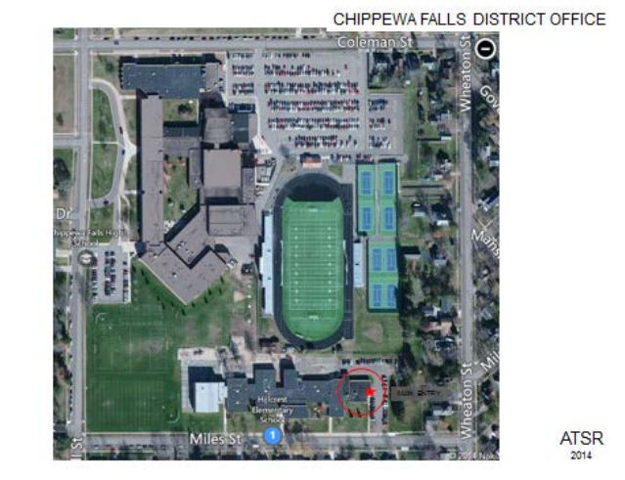
District Office

Slide 47
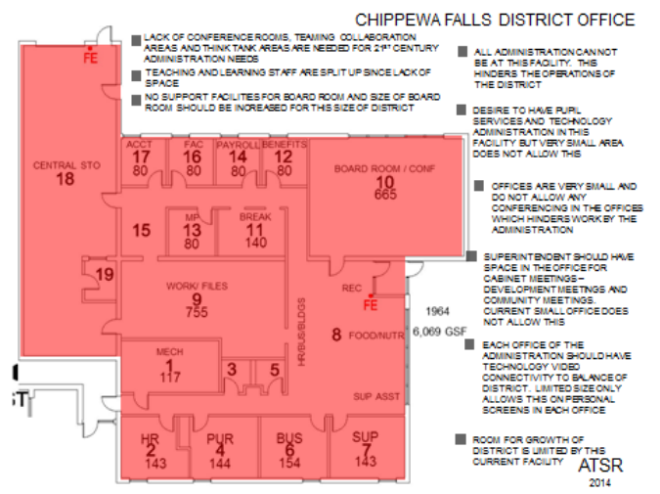
District Office

Slide 48
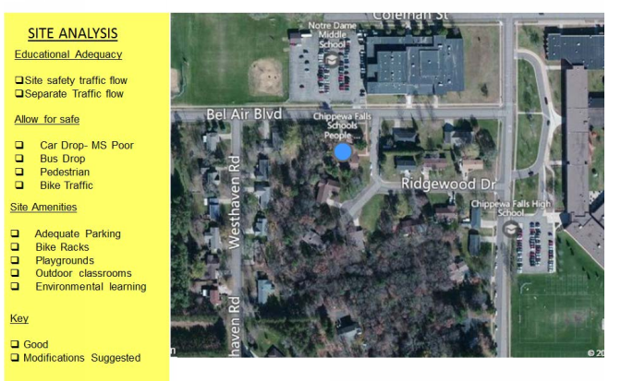
Pupil Service Center

Slide 49
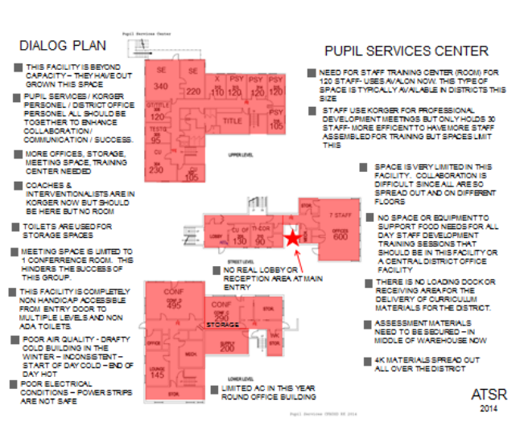
Pupil Service Center

Slide 50
Reflections/Understandings
What are some of the ‘key take-aways’ that you heard related to the conditions/needs of the district service center(s)?

Slide 51
Financial Planning and Facility Updates

Slide 52
Insert Series of Slides Related To School Finance!

Slide 53
Reflections/Understandings
What are some of the ‘key themes’ that you heard in these presentations?

Slide 54
Next Meeting and Future Meeting Dates
Next Meeting: Tuesday November 17th
  Tentative Agenda: New Directions/Building Solutions
Future Meeting Dates: Monday November 30th and Monday December 14th.

Slide 55
Chippewa Falls
Facilities Task Force
Fall 2015

Slide 56
Agenda for Meeting Three
Review Planning Process
Presentation of Education Evolving
Reflections/Understandings
Presentation of New Directions
Reflections/Understandings
Committee Aspirations
Next Steps Meeting Calendar
Notes:
Review of Planning Process (5 min)- Briefly review the ‘charge’ of committee and the work completed to date.
Education Evolving (15 min)- Brings back some of the ‘history’ of educational change from the first meeting and lays the foundation for the ‘directions’ presentation later in the meeting by describing the many changes in the teaching/learning process.
Large Group (10 min)- This is a ‘quick takeaway’ activity that gets committee members to reflect on what they just heard and identify ‘key themes’. These ideas will become the underpinnings against which future options are measured.
New Directions- (15 min) This is a presentation that shows how spaces are now being designed to accommodate the changes in learning
Large Group- (45 min) Committee members will use a variety of ‘stuff’ to create their own learning spaces. It’s a ‘hands on’ approach that helps people to see the possibilities.
Solutions (15 min)- This is a review of the previous solutions that have been given consideration
Measuring Up (15 min)- Force Field Analysis; overlaying current solutions against ‘vision’ for schools
Next Steps (5 min)- A review of the planning calendar and a look ahead
Time for planning process: 105 minutes
Note: Between this session and the next, a Monkey survey will be sent out to participants. Information gathered will include thoughts about adequacy of existing facilities as well as past solutions.

Slide 57
Review The Planning Process
The purpose of the Future Facilities Planning Committee will be to, “…. review all information that has been developed for, and approved by, the Chippewa Falls Area Unified School District Board related to the current conditions of CFAUSD facilities and make recommendations to ensure its facilities support 21st century learning….”
The process that will be used in the development of the recommendation will:
  Involve participation in five (5) meetings that will take place over a period of ten (10) to twelve (12) weeks
  Be inclusive in nature; recognizing the importance of both individual thought as well as consensus of small group and large group ‘think.’

Slide 58
Education Evolving
C ompetence
C ommunication
C ollaboration
C reativity
C onsumerism

Slide 59
Reflections/Understandings
What are some of the ‘key take-aways’ that you heard in this presentation?

Slide 60
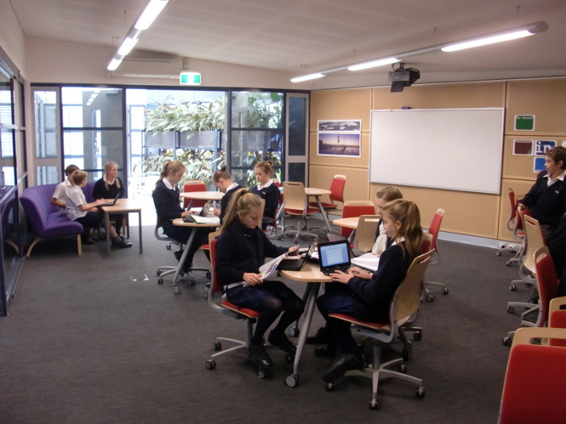
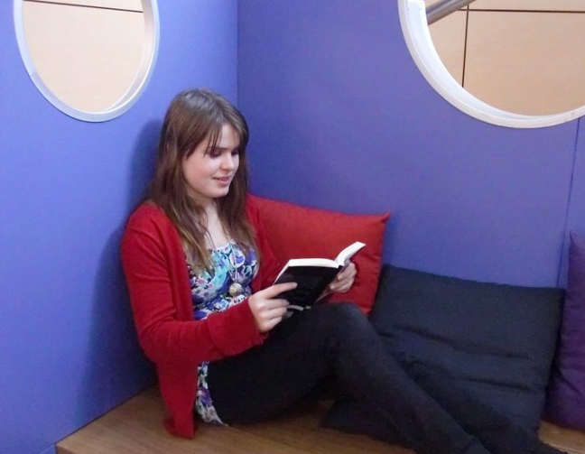
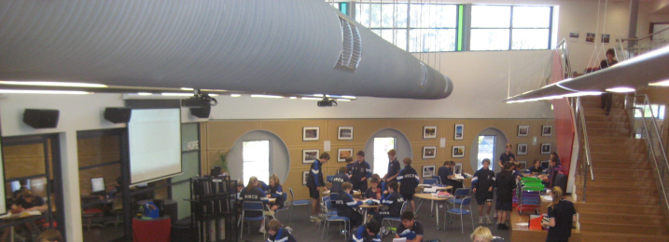

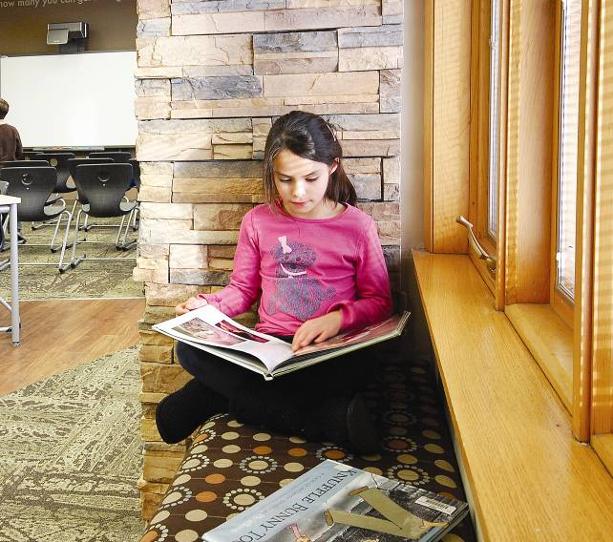
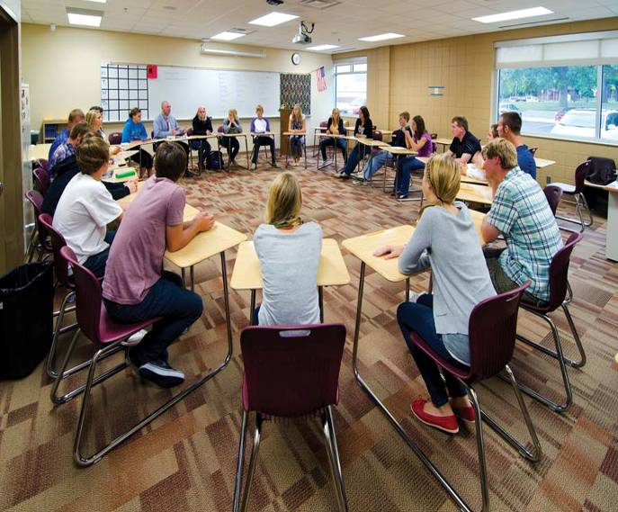
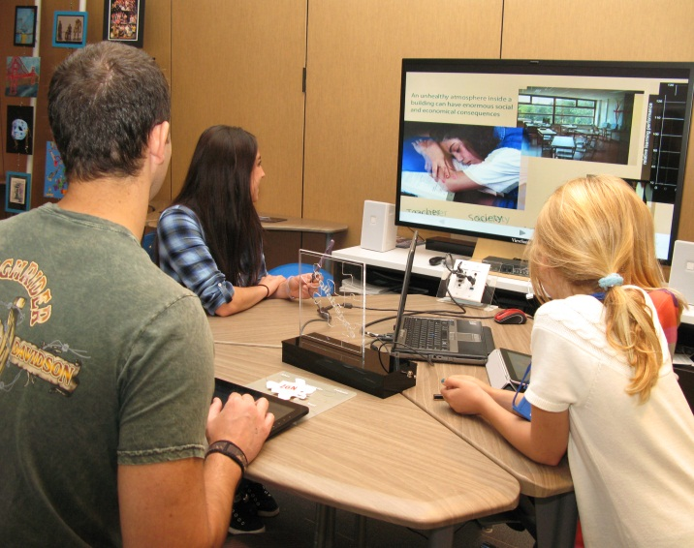
“Making a 21st Century School”
Independent Collaborative Communication

Slide 61

Change is Driven: By the Next Generation’s Expectations
Where is learning happening?
What are students looking for?
How will education be delivered?

Slide 62
School Design Supports:
Differentiated Instruction
Creative “Play”/Imagination
Flexible Learning Design
Individualized Learning
Collaborative Teaming

Slide 63

Collaborative Teaming
C
O
L
L
A
B
O
R
A
T
I
O
N

Slide 64
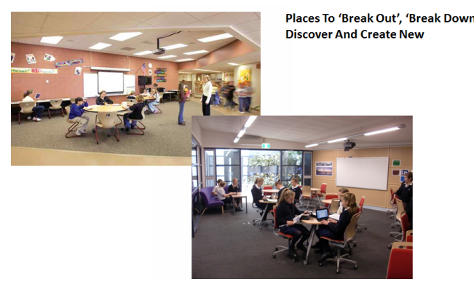
Creative Play
C
R
E
A
T
I
N
G

Slide 65
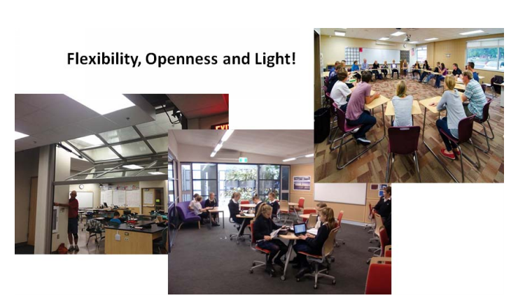
Flexible Learning Design
S
M
A
L
L
&
L
A
R
G
E

Slide 66
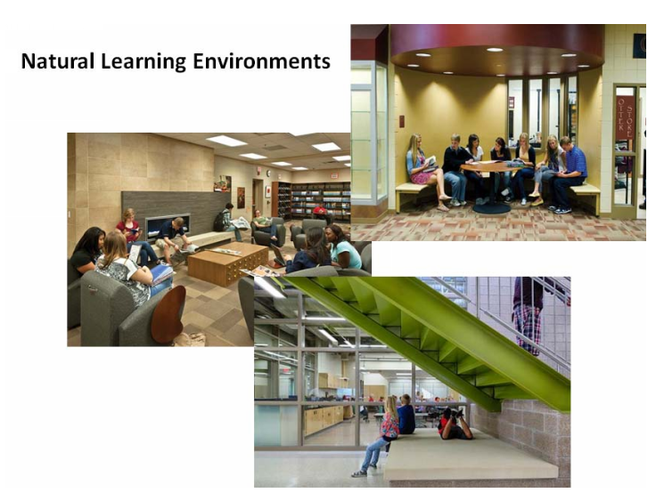
Collaborative Teaming
C
O
L
L
A
B
O
R
A
T
I
O
N

Slide 67
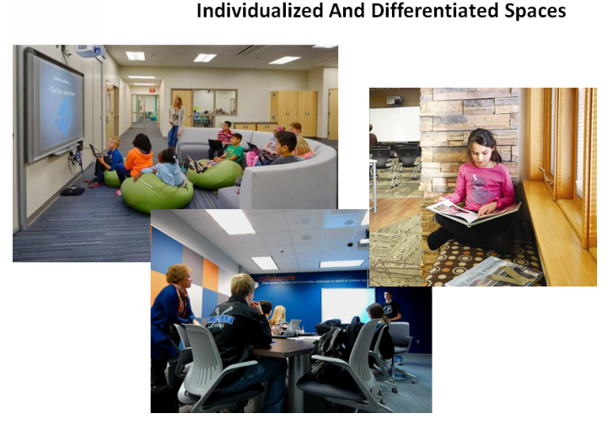
Differentiated Instruction
I
N
D
I
V
I
D
U
A
L
&
G
R
O
U
P

Slide 68
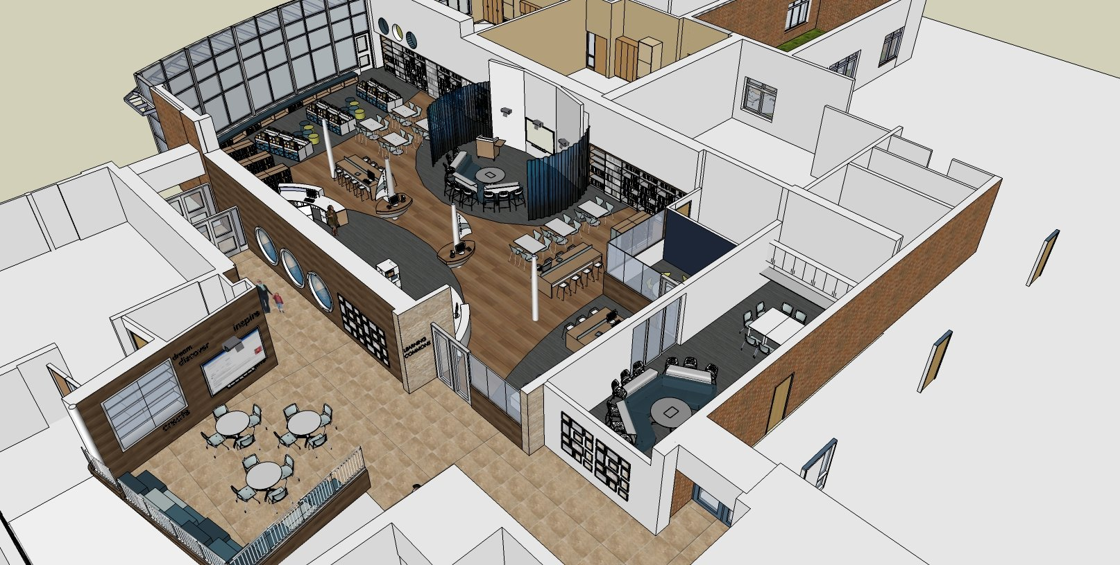
21st Century Flexible Room Design: Media Center
Book Shelves (traditional)
High-chairs for independent study
E-classroom
Collaboration
Glass partitions for ease in supervision
Small Group Instruction

Slide 69
Reflections/Understandings
Design Your ‘favorite’ learning space?

Slide 70
Facility Design
What ‘aspirations’ should the community of Chippewa Falls and the surrounding area have of its educational system? What changes might be necessary to meet those expectations?

Slide 71
Next Meeting and Future Meeting Dates
Next Meeting: Monday November 30th
  Tentative Agenda: “Finding a Pathway Forward”
Future Meeting Date: Monday December 14th.

Slide 72
Chippewa Falls
Facilities Task Force
Fall 2015

Slide 73
Agenda for Meeting Four
Review Planning Process
Presentation of Survey Results
Review of Options
Conduct Force Field/Forced Choice Analysis
Generate Consensus
Next Steps Meeting Calendar
Notes:
Planning Review (5 min)- A simple review of the planning process
Survey Results (15 min)- The survey should provide excellent feedback and clarify the most critical questions. The first half of the survey will help define parameters such as space priorities and funding. The second part of the survey will provide clarity related to the various options.
Option Review (15 min)- The top 3 options will be thoroughly reviewed
Force Field/Force Choice (30 min)- Each small group will look at positives and negatives for top three options and report to large group. Based upon the results, a final solution will be determined.
Consensus (10 min.)- Large group discussion
School Board Recommendation (20 min)- Small group (if necessary) develops a final recommendation for Board approval
Next Steps (10 min)- Review all of the work and discuss the importance of creating a ‘pathway to success’ for board consideration
Total Planning Time: 105 minutes

Slide 74
Review The Planning Process
The purpose of the Future Facilities Planning Committee will be to, “…. review all information that has been developed for, and approved by, the Chippewa Falls Area Unified School District Board related to the current conditions of CFAUSD facilities and make recommendations to ensure its facilities support 21st century learning….”
The process that will be used in the development of the recommendation will:
  Involve participation in five (5) meetings that will take place over a period of ten (10) to twelve (12) weeks
  Be inclusive in nature; recognizing the importance of both individual thought as well as consensus of small group and large group ‘think.’

Slide 75
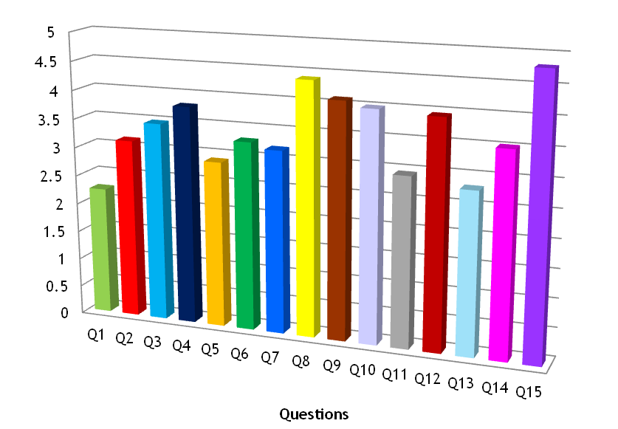
Survey Results
At least 80% concur
When compared to all other concerns noted in the survey, the large majority of respondents believe the most important concerns to be:
i) maintaining class sizes and school electives
ii) providing additional core space at both the middle school and high school.

Slide 76
Most ‘Preferred’ Options
Based upon the findings of the survey, what is the single most preferred option for moving forward?

Slide 77
Pathway Forward
For each of the top three (3) options, conduct a force-field analysis that identifies the primary ‘blockers’ and primary ‘energizers’ for each.

Slide 78
Next Meeting
Next Meeting: Monday, December 14th
  Tentative Agenda: Developing a set of Recommendations for Board Consideration

Slide 79
Chippewa Falls
Facilities Task Force
Fall 2015

Slide 80
Agenda for Meeting Five
Develop Recommendation(s) for School Board Consideration
Thanks
Notes:
Review Recommendation to the Board (10 min)
Identify Steps leading to successful bond levy (Whatever Time Needed!)
Thank You

Slide 81
Measuring Up!
Of the options that have been given consideration, conduct a force-field analysis that identifies the primary ‘blockers’ and primary ‘energizers’ for each option

Slide 82
School Board Recommendation
We, the Chippewa Falls Area Unified School District Facilities Committee, after conducting a comprehensive review of all data and information related to our District’s facilities recommend the following…

Slide 83
Thanks for a Job Well Done!

Slide 84
Working Agenda: Meeting One
The purpose of this meeting will be to get acquainted with the planning team and to lay the foundation for the work that needs to be done.
Meeting Introductions:
This is an activity. Committee members will introduce themselves and identify/state their expected outcomes for serving on the committee. The anticipated time of this activity is 20-30 minutes.
Educational Change:
  This is a presentation. The Planning Team will learn about the ‘history’ of educational change; overlaying educational changes with the changes in facilities in the LSD. The anticipated time of this activity is 30 minutes.
Imagine:
  This is an activity. The planning team members will share their personal ‘vision’ for their school district. “..when I dream…” This will be conducted from the individual reflection to small group sharing to large group discussion. The anticipated time of this activity is 40 minutes.
Information Gathering:
  This is an activity. Planning team members are given the opportunity for identify what information they might need in order for them to be able to complete their task. The anticipated time to complete this activity is 15 minutes.

Slide 85
Working Agenda: Meeting Two
The purpose of this meeting will be to provide important information for the planning team. A detailed review of the Facility Plan will be provided as well as any other pertinent information (i.e enrollment trends, history of bond and levy initiatives etc.).
Opening of Meeting-Old Business:
  This is a large group feedback activity. A brief review of the outcomes from the first meeting will be provided and committee members will be given an opportunity to raise issues/concerns. The anticipated time to complete this activity is 5 minutes.
Facility Study Review:
  This is an opportunity for the planning team to ‘listen and learn’ about their current facilities. A detailed review of the facilities study conducted by ATSR will be made. At regular intervals, time will be taken to give planning team members the opportunity to respond to the questions: “What are the key themes that you’ve heard? What are your critical takeaways?” The anticipated time to complete this activity is 60-75 minutes.
Pertinent Data Review:
  Beyond the condition of the District’s facilities, there are other factors that might influence the decisions made by the planning team. It is important to review and discuss other key influencers such as school demographics, facility utilization and cost/tax implications. Throughout this discussion, planning team members will be given the opportunity to respond to the questions: “What are the key themes that you’ve heard? What are your critical takeaways?” The anticipated time to complete this activity is 35 minutes.

Slide 86
Working Agenda: Meeting Three
The purpose of this meeting will be to create within the planning team, a sense of vision; a recognition that schools and the teaching/learning process operate much differently than they have in the past.
Opening of Meeting-Old Business:
  This is a large group feedback activity. A brief review of the outcomes from the first two meetings will be provided and planning team members will be given an opportunity to raise issues/concerns. The anticipated time to complete this activity is 5 minutes.
Creating a Bridge to the Future:
  This is a large group to small group listen, learn and share activity. The planning team will be provided with a ‘history of change’ in public schools and reflect upon how its own schools have evolved. The anticipated time to complete this activity is 25-30 minutes.
Form Follows Function:
  This is a large group to small group listen, learn and share activity. The planning team will be provided with information related to how building designs have changed to accommodate the changes in the teaching/learning process. Team members will then have an opportunity to identify spaces within their current facilities that best reflect these changes. The anticipated time to complete this activity is 25-30 minutes.
Aspirations:
  This is a presentation to the planning team outlining the ‘Aspirations’ that could become a reality for the District. This will lay the foundation for the planning team’s work in meeting four. The anticipated time to complete this activity is 25-30 minutes.

Slide 87
Working Agenda: Meeting Four
The purpose of this meeting will be to begin the identification of the ‘pathway forward’ for the school district. Planning team members will be given the opportunity to design options that might be considered to address the most critical facility and educational needs of the district.
Open Meeting/Old Business:
  This is a large group feedback activity. A brief review of the outcomes from the first three (3) meetings will be provided and planning team members will be given an opportunity to raise issues/concerns. The anticipated time to complete this activity is 5 minutes.
And the Survey Says:
  This is a large group to small group listen, learn and share activity. Survey results will be shared with planning team members. Planning team members will be given the opportunity to respond to the question: “What are the key themes that can be learned from the survey”? The anticipated time to complete this activity is 50 minutes.
Planning the Future:
  From small group discussion to large group sharing, planning team members will outline a framework for school repair/betterment and redesign. The anticipated time to complete this activity is 50 minutes.

Slide 88
Working Agenda: Meeting Five
The purpose of this meeting will be to establish a single solution (or set of solutions) that will address the facility needs of the District. Time will also be spent on the development of a recommendation as well as a set of steps the planning team believes need to be taken by the school board to provide the best possible outcome in moving the District forward.
Open Meeting- New Business:
The planning team will review the solutions proposed in the previous meeting. Through small group discussion and the use of force field analysis, a solution, or set of solutions will be developed for board consideration. The anticipated time to complete this activity is 90 minutes.
Implementation Strategies:
The planning team will develop a set of steps it believes the school board should take in order to maximize the opportunities for successfully addressing it facility needs. The anticipated time to complete this activity is 30 minutes.

Slide 89

New Directions

