Slide 1


Slide 2
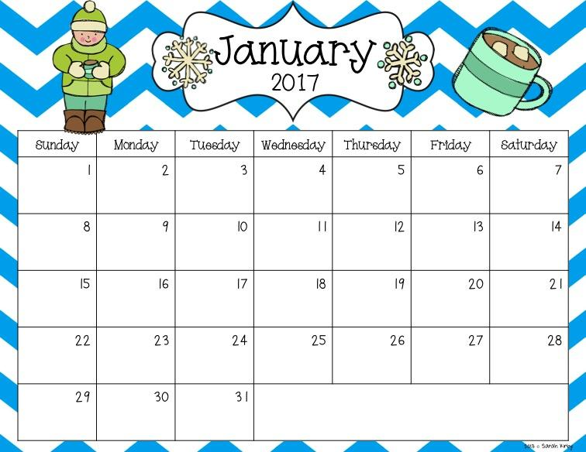

Slide 3
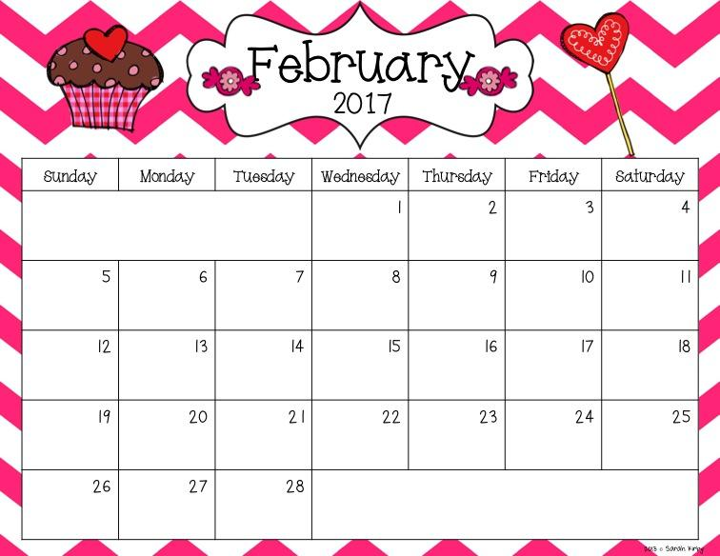

Slide 4
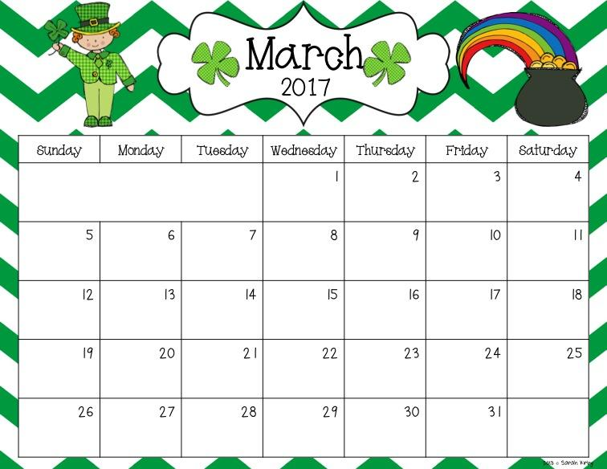

Slide 5
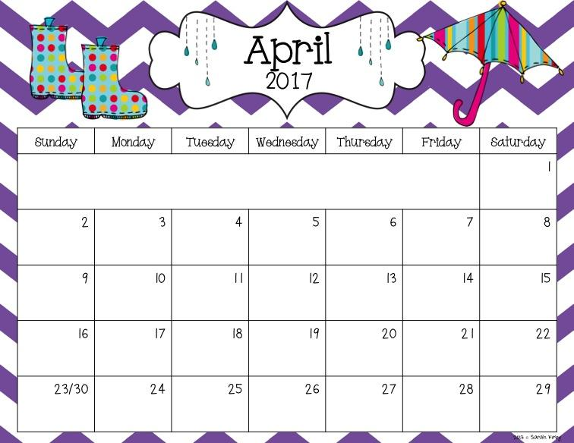

Slide 6
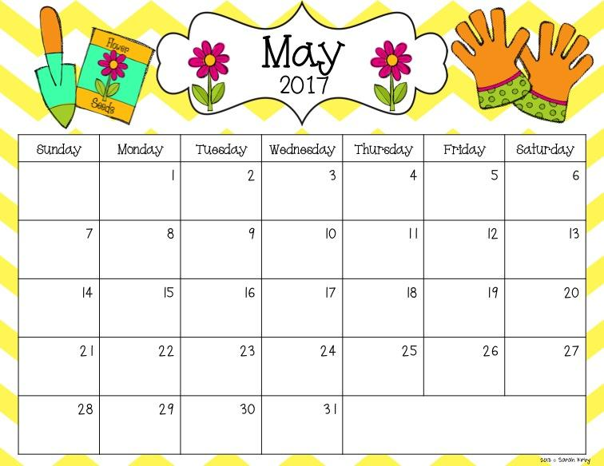

Slide 7
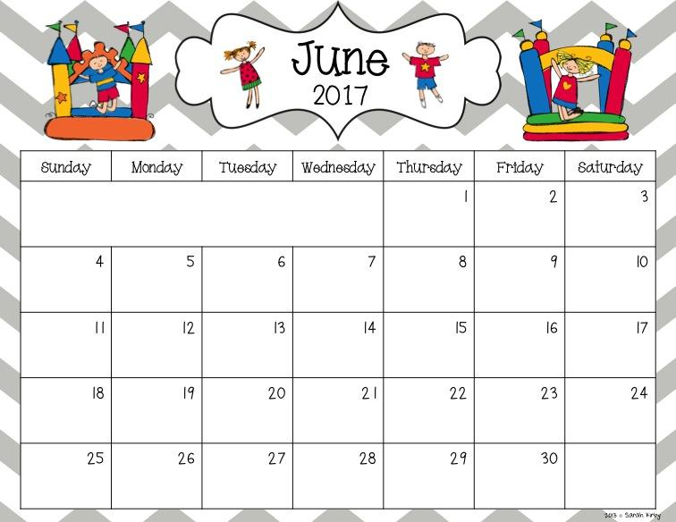

Slide 8
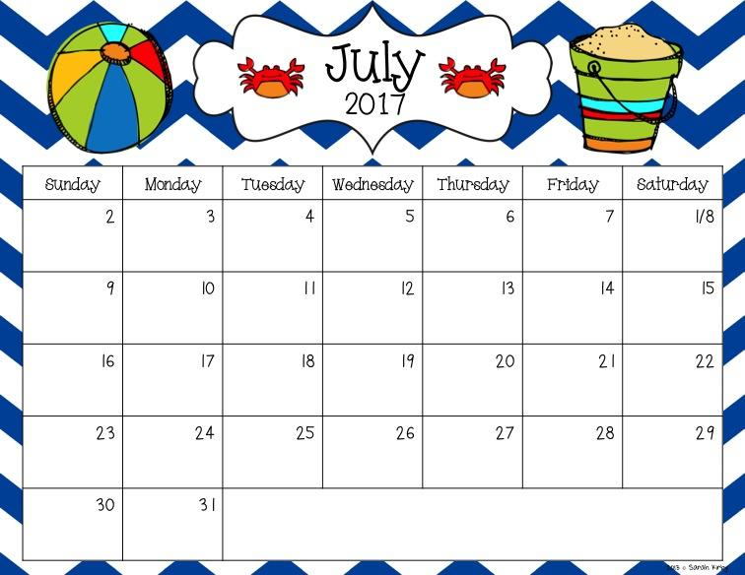

Slide 9
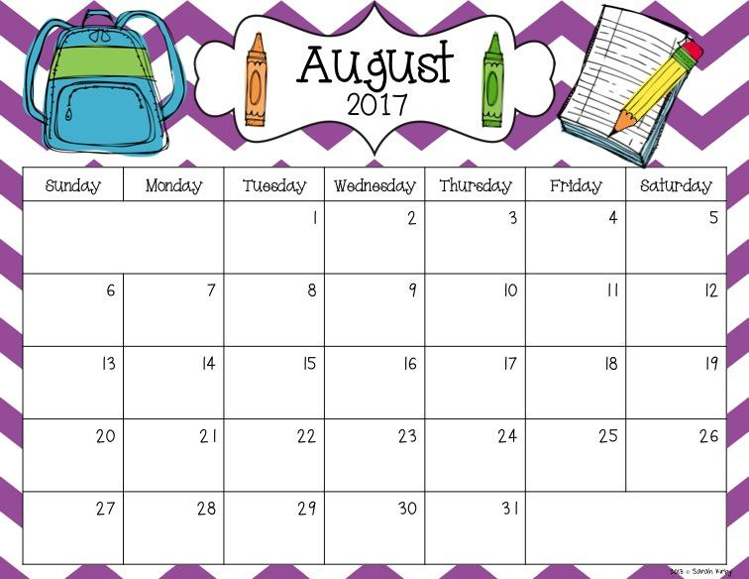

Slide 10
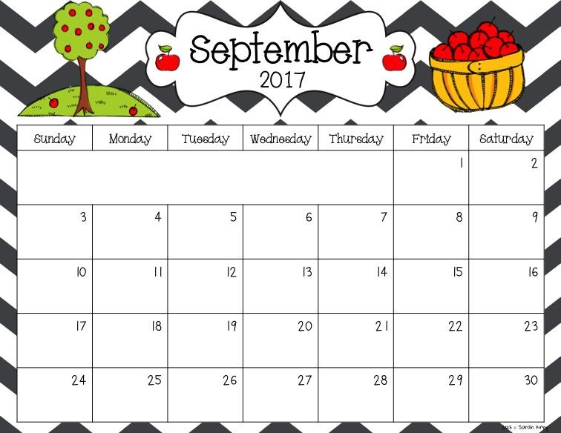
Happy birthday, Carter!
Open House at Parkview
Half of the class comes today! Wear your Kindergarten t-shirt!
The other half comes today! Wear your Kindergarten t-shirt!
Everyone comes today!!
Wear your Kindergarten t-shirt!
Happy birthday, Adalynn!
No School
Red Day!
Wear red and bring red show & tell!
Theme: Colors
Orange Day! Wear orange and bring orange show & tell!
Yellow day!
Wear yellow and bring yellow show & tell!
Green Day! Wear green and bring green show & tell!
Blue Day!
Wear blue and bring blue show & tell!
Purple Day!
Wear purple and bring purple show & tell!
Happy Camper:
Adalynn
Theme: Colors
Pink Day!
Wear pink and bring pink show & tell!
Black and Gray Day!
Wear black or gray and bring black or gray show & tell!
White Day!
Wear white and bring white show & tell!
Happy birthday, Hakan!
Happy Camper:
Hakan
Brown Day! Wear brown and bring brown show & tell!
Early Release
Favorite Color Day! Wear your favorite color!
Theme: Apples
Happy Camper:
Carter

Slide 11
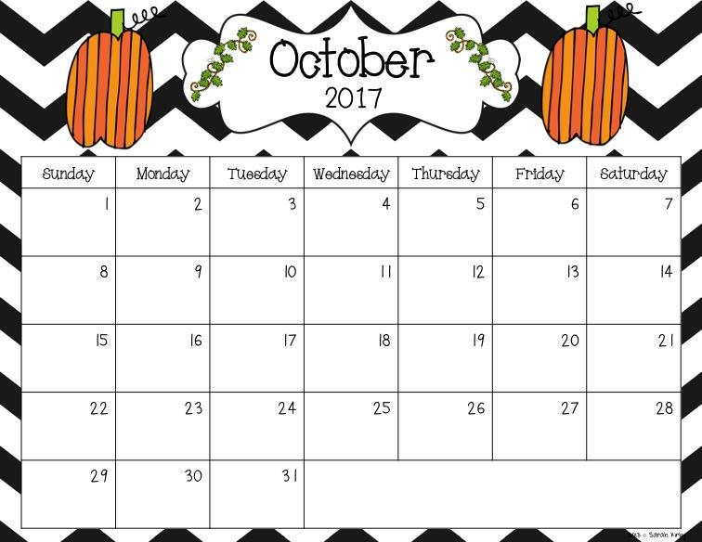
Theme: Fall Changes
Field Trip to Heyde Center to watch a play!Wear your kindergarten tshirt!
Theme: Fire Safety
Packers Vs Vikings this weekend! Wear your favorite team’s clothes today!
Theme: Pumpkins
Happy Birthday, Jasper!!
Happy Camper:
Jasper
Theme: Halloween
Early Release
No School
Theme: Halloween and Scarecrows
Happy Halloween!
Kinders can come to school in their costumes!

Slide 12
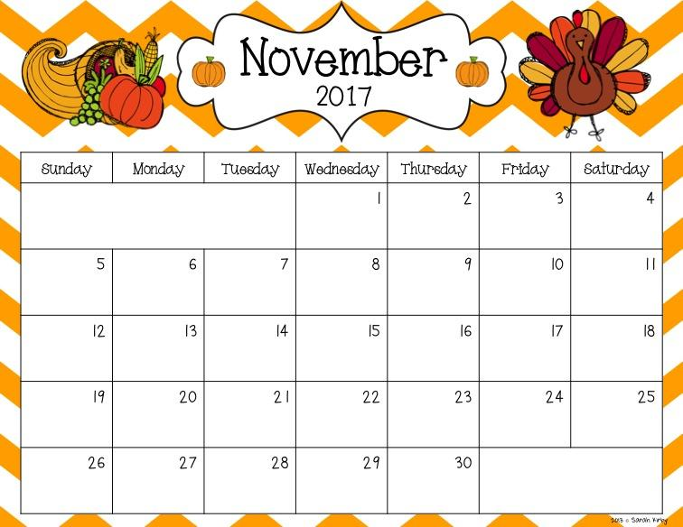
Theme: Families
Parent-
Teacher Conferences
3:00-7:00
Parent-
Teacher Conferences
3:00-7:00
Theme: Thanksgiving
K-1 Family Night at Parkview
No School
No School
No School
No School- Happy Thanksgiving!
No School
Happy Birthday, Gage!
Happy Camper:
Gage
Theme: Author Study- Karma Wilson and Jane Chapman

Slide 13
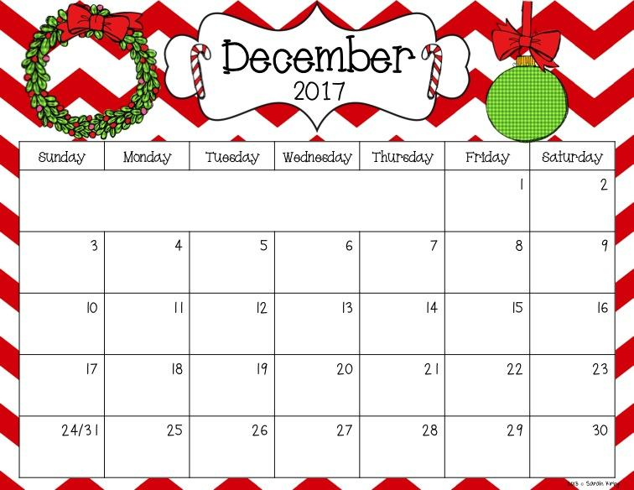
Theme: Reindeer
Happy Camper:
Aurora
Theme: Our family’s traditions
Happy Birthday, Adam!
Hot Cocoa Day! Bring a mug from home!
Ugly Christmas Sweater Day too!
Happy Camper:
Adam
Cookie Decorating Party
Theme: Christmas
Happy Birthday, Mrs. Parker!
Happy Camper:
Olivia
Pajama Day!
Happy Birthday, Olivia!
No School
No School
No School
No School
No School
Merry Christmas and Happy New Year! Enjoy your week!

Slide 14
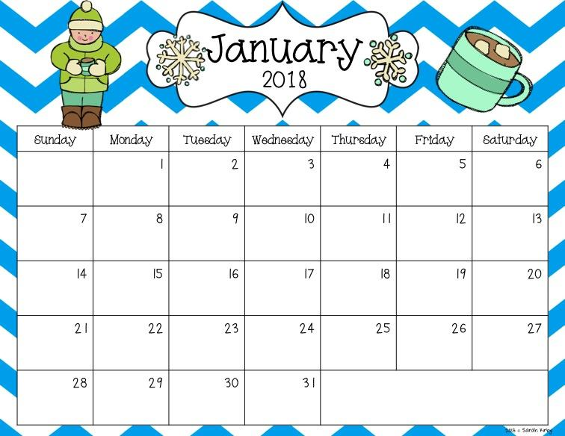
Theme: Winter Changes
Happy Camper:
Madilyn
No School
Cozy Socks Day!
Theme: Author Study: Mo Williams
Bring your favorite stuffed animal today!
Happy Camper:
Adeline
Early Release
No School
Theme: Space
Happy Camper:
Audrey
Theme: Groundhog’s Day
Happy Camper:
Emersyn

Slide 15

Happy Birthday, Jakrya!
Theme: 100th Day and Valentine's Day
Happy Camper:
Jakrya
Theme: 100th Day and Valentine's Day
Happy Valentine’s Day!
Early Release
100th Day!
Theme: Dental
Theme: Dr. Seuss
Cat In the Hat Day- Hat Day!
Put Me In the Zoo- Bring a Stuffed Animal to school
Green Eggs and Ham Day! Dress like your favorite Dr. Seuss Character
Happy Camper:
Blake

Slide 16

Happy Birthday, Blake!
Fox In Socks Day:
Wear silly socks
Horton Hears a Who Day! We will make HJorton ears at school!
Theme: Dinosaurs
Happy Camper:
Cora
Parent Teacher Conferences tonight
Parent Teacher Conferences tonight
Theme: St. Pats’s Day
Wear Green for St. Patrick’s Day!
Happy St. Patrick’s Day!
Happy Camper:
Max
Happy Birthday, Cora!
Happy Birthday, Max!
Spring Break!
Happy Birthday, Nolan!
No SChool! Enjoy your break!
Theme: Easter
No School
Happy Camper:
Nolan

Slide 17
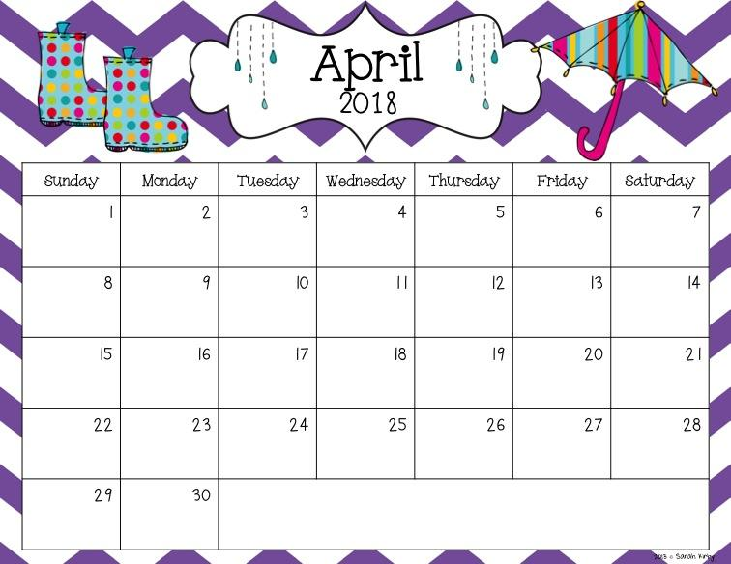
Happy Easter!
Theme: Spring
Happy Camper:
Ryker
Theme: Earth Day & Plants
Happy Birthday, Ryker!
Happy Camper:
Lilly
Early Release
Happy Birthday, Lilly!
Theme: Author: Eric Carle
Happy Birthday, Carson!
Happy Birthday, Tannen!
Our class will go to Wissota State Park!
Happy Camper:
Carson
Theme: Ocean
Happy Camper:
Tannen
Theme: Frogs

Slide 18
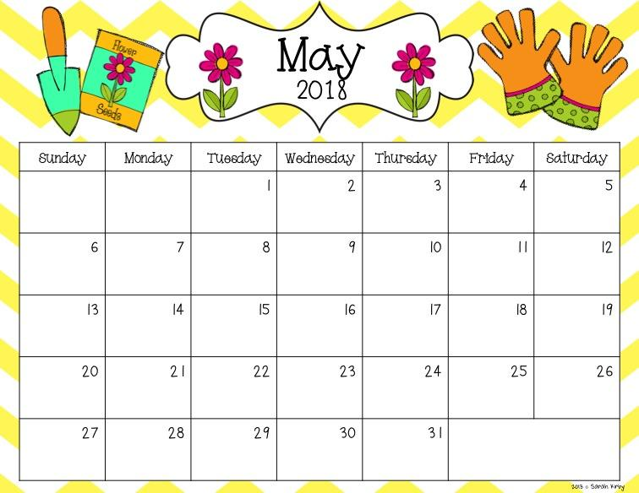
Happy Birthday, Cameron!
Happy Camper:
Cameron
Happy May Day!
A to Z to Summer Countdown Begins!
Parkview’s Walk or Ride Bike to School Day
Theme: Community Helpers
Happy Birthday,
Kaisyn!
Happy Camper:
Kaisyn
No School for Kindergarten!
Theme: Farm
Theme: Author Study: Laura Numeroff
Happy Birthday, Coltin!
Happy Camper:
Coltin
Theme: Camping
Looking Ahead:
*June 5th: Kindergarten Program for parents in afternoon
*June 8th: Last day of school & early release
NO SCHOOL

Slide 19


Slide 20
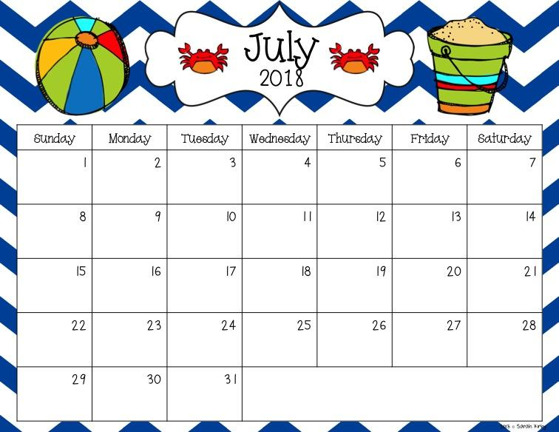

Slide 21


Slide 22
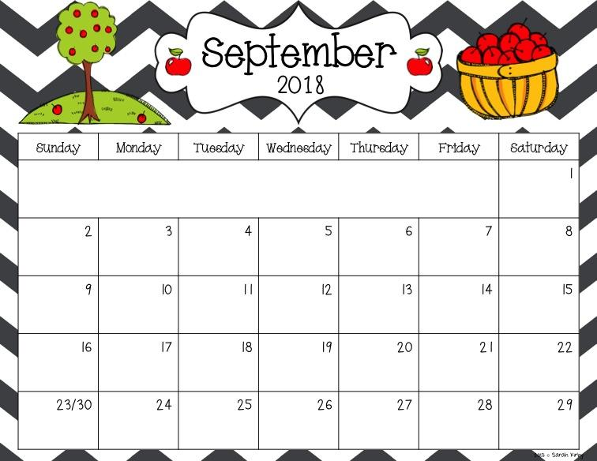

Slide 23
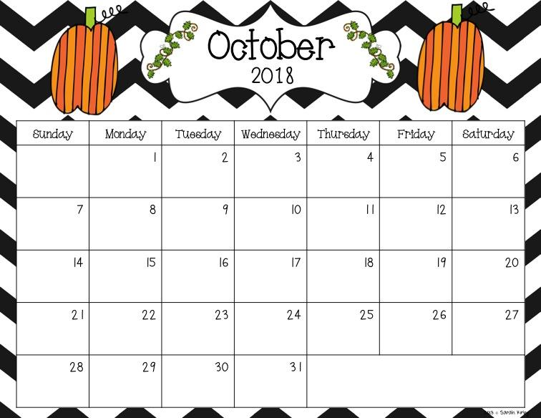

Slide 24
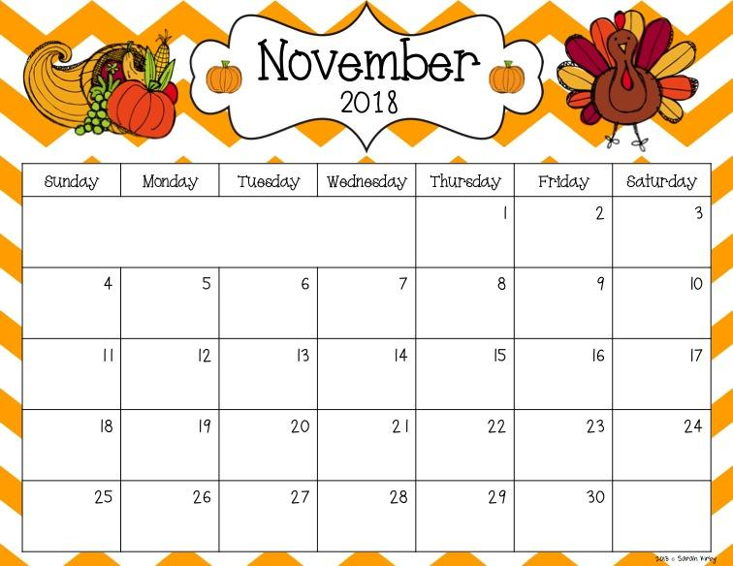

Slide 25
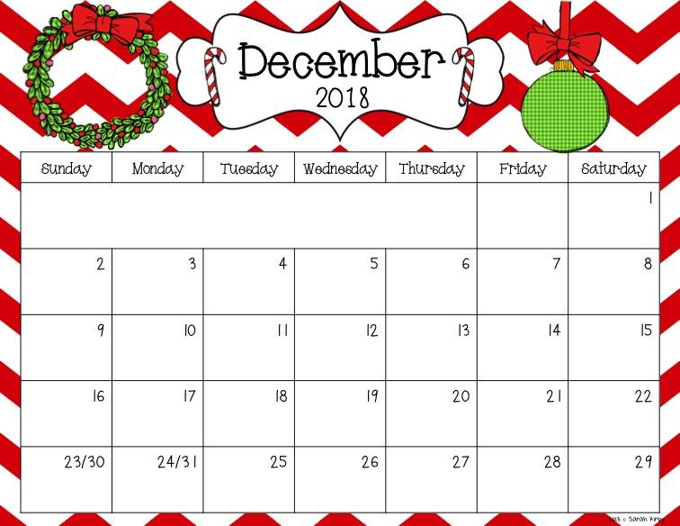

Slide 26


